Slide 1


Slide 2

Purity of Soul (Takhlea)
Wilayat
Honesty – always favour the right
Aql
Zikr
Hidayat
Actions (Amal)
Quality (Sifat)
Marefat
Signs of Allah
Awakening/Awareness
Question: Where is SHARIAT IN THIS diagram?
IMAAN

Slide 3



Clearing up the Definitions
The problem of Life is not solved by Ilm or Marefat alone, until the Marefat is transformed into Aql and submission of hearts before Allah (Khasheat)

Slide 4

Setting up the Parameters of Hidayat
The entity that attains HIDAYAT or goes astray is no one except Human Soul or NAFS.
Quran has used the key word to illustrate the true shape (not only state) of NAFS.
Every shape is defined by certain characteristics and exhibit certain properties when put into action or used in the real life situations.
Therefore, the key characteristics of a NAFS that has attained Hidayat are:
1. BANDAGI of Ultimate and Absolute Truth – That is how he understands and accepts Allah
2. HIKMAT which defines the capability to identify and unambiguously distinguish the True from False and Right from Wrong
These core Sifaat generate a whole lot of Sifaat e Hasanah which eventually constitute the Garden of Soul or Jannah for the momin blessed with Hidayat e Haq.

Slide 5



Baqarah- V. 269
Hikmat = Aql + Adl
Bandagi = Khasheyat + Love
Taqwa
Husn e Akhlaq
Al-Anfal - V. 29
Bani Israel – V.39
Taqwa = God consciousness which leads to abstinence from every thought and act which Allah does not like
Akhlaq = Attitudes and Behaviours emanating from the Shakelah as
Al-Anaam – V. 153

Slide 6
Why Akhlaq are the fruits and ultimate manifestation of the reality of soul (NAFS)?
Qualities or Sifaat in essence are highly metaphysical and cannot be directly sensed or measured. Like we have no gauge to measure the existence and purity of Bandagi or Taqwa in a soul !!
That’s why Allah has established the system of Akhlaq and Aamal. Akhlaq is the cumulative or resultant form and outlook of the soul. While Amal is the manner in which this shape expresses itself and executes his will in the outside world.
Strength Muscles Weightlifting or Effort
Strength is an abstract quantity which takes the form or shape of a muscular body. Finally, that body will exhibit the strength through more efforts or lifting and carrying of large loads.

Slide 7
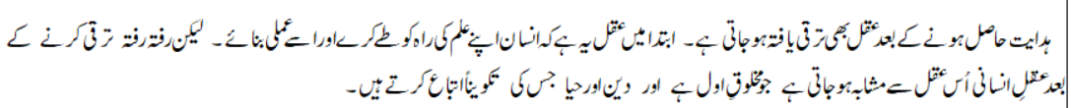
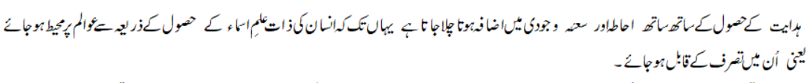
Consequences and Fruits of Hidayat

Slide 8


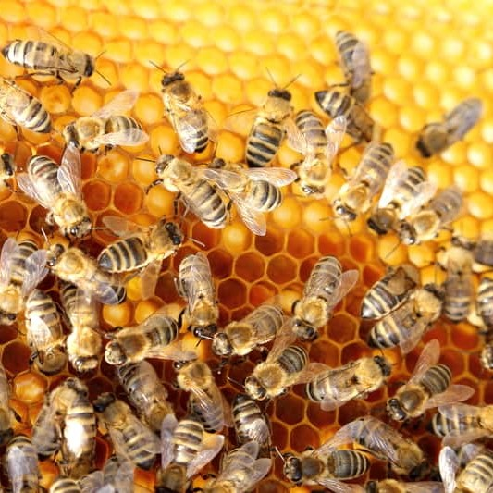

Please describe in your words the Hidayat that you can obtain from A or B
A. Egg and Chicken
B. Honeybee and her hive full of honey

Slide 9


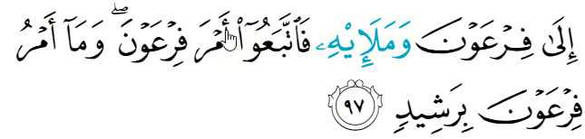

Hidayat now leads to journey (growth) towards Goal and Purpose of Creation
Are these two verses of Sura Hood and the verse of Sura Taha (below) telling us about the importance of Wilayat for being Guided or

Slide 10


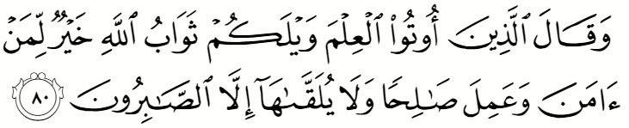
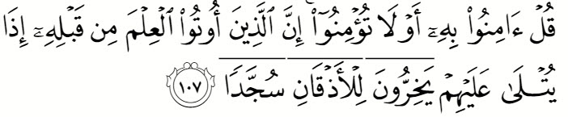
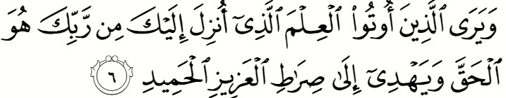
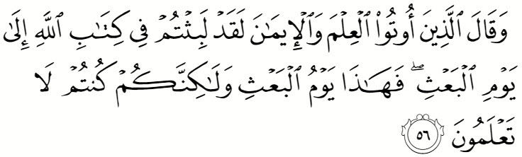
Final Destiny – Allah shares His secrets with You and makes you His spokesperson (True Khalifa whose eyes , ears and hands are owned by his Rab)

